Slide 1
System Models

Slide 2
System Models
Processes run on processors.
In traditional system there is only one processor so there is no question like how processors should be arranged.
But here in Distributed System we have multiple CPUs available so here it is a design issue.
So here multiple CPUs Can be organized in several ways.

Slide 3
So the different ways into which we can arrange or organize the multiple CPUs are the System Models.
There are three popular models available namely
1. The Workstation Model
2. Processor Pool Model
3. Hybrid Model

Slide 4
The Workstation Model
This one is the very simple and straight.
Here, the Distributed System consists of number of workstations connected by the high speed LAN scattered thought-out the building.
At any instant one user may be using any one of the workstations or that workstation may be idle.
So here some of the workstations may be occupied whereas some may be idle. Right!

Slide 5
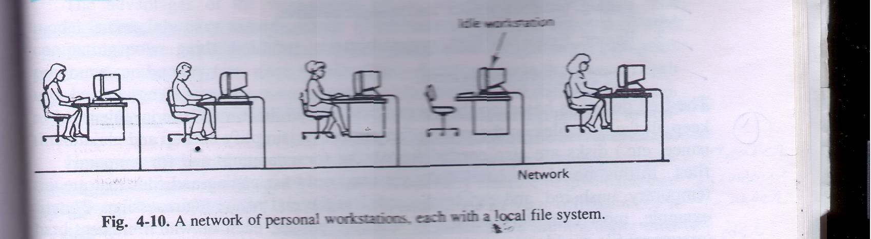
The Workstation Model Continue……..

Slide 6
The Workstation Model Continue……..
The workstations which has been shown in the previous slide might be having disks at their disposal or they might not be having.
So here we can have two types even based on the fact that workstation contains disk or not.
Distributed System having Diskless workstations( workstations without disks) And Distributed System having Disk full workstations(workstations with disks).

Slide 7
The Workstation Model Continue……..
So if former is the case that means if the distributed system is diskless or the workstations are not having disks then it is obvious that file system will not be local and it will be provided by the one or more remote servers.
So here every request for reading or writing the files are sent to the file server, which performs the work and sends reply back.

Slide 8
The Workstation Model Continue……..
This model of Distributed System(Diskless) is useful for several reasons.
1. Having the large number of workstations with disks which are small, slow is typically much more expensive than having one or more file servers equipped with huge, fast disks and accessed over the LAN.
2. Popular because of its ease of maintenance…..

Slide 9
The Workstation Model Continue……..
For example suppose new release of some program, say some system programs like compiler comes out then it can be installed on small number of file servers so here we do not require to install it all each workstation.
  3. Diskless workstations provide symmetry and flexibility because user can use every time different workstation since file system is not local.

Slide 10
The Workstation Model Continue……..
Now consider later case means Distributed System having local disks or workstations having disk.
But here even we might be using disks for any one of the following purposes.
1. For storing only paging and temporary files.
2. For storing only paging, temporary files, and
system binaries.
3. For storing only paging, temporary files, system binaries, and file caching.

Slide 11
The Workstation Model Continue……..
  4. For storing complete file system.
  So as you might have perceived that with increasing number network traffic will decrease.
  That means if we use local disk only for the purpose of paging and temporary files then for rest of work like reading files, writing files requests will have to be sent to file servers.
  Keep in mind that for first three we require both local disk and file servers, but for last option that is forth one that uses disks for complete file system eliminates need for the remote file server.

Slide 12
Disk Usage | Advantages | Disadvantage
(Disk less) | Low cost, easy h\w and s\w maintenance, symmetry and flexibility | Heavy n\w usage, file servers may become bottlenecks.
Paging, Scratch files | Reduces n\w load over diskless case. Obvious thing ! | Higher cost due to large # of disks needed.
Paging, scratch files, binaries | Reduces n\w load even more. | Higher cost; additional complexity of updating the binaries
Paging, scratch files, binaries, file caching | Still lower n\w load. Reduces load on file servers as well. | Higher cost; cache consistency problems.
Full local file system | Hardly any n\w load. Eliminates need for file servers. | Loss of transparency.
Disk usage on workstations

Slide 13
So one thing is clear we can have Distributed System
1. D S without disks that is diskless.
2. D S with disk but only for paging and temporary or scratch files and for file system we have file server as well.
3. D S with disk but only for paging, temporary files and system binaries for file system we have file server as well. .
4. D S with disk but only for paging, temporary files, binaries and file caching for file system we have file server as well. .
5. D S with disk that provides complete file system and here no need for file servers..

Slide 14
The Workstation Model Continue……..
But here as we had seen in one of the previous slides that some of the workstations may be busy while some may be idle. Right!
And as we know that Distributed System should present to its users a single virtual uniprocessor image, that means a user is not aware that where his\her work is being completed that means here if load of the particular machine is more then its some of the processes can be migrated or moved on some idle machine.
So question is that how to make use of this idle workstations.

Slide 15
The Workstation Model Continue……..
That means using idle workstation is also a issue here.
The earliest attempt or earlier way of using idle workstation was the rsh program or command that comes with Berkeley UNIX.
This program is called by rsh machine_name command.
That means rsh command runs specified command on specified machine.
1. so here responsibility for identifying idle workstation is totally on the users.

Slide 16
The Workstation Model Continue……..
So another way or algorithm for utilizing idle workstations got developed.
This algorithm used to locate idle workstations can be divided into two categories:
- server driven*
- client driven
* server driven approach is also called registry based algorithm because here registry is maintained either centrally at one place or alternatively may be at local machine so here each user will have its on copy of registry.

Slide 17
Server Driven
In the former approach when the workstation goes idle and thus becomes a potential computer server, it announces this fact and its entry is made in central registry file which might be maintained by any common server.
It can do this by entering its name, network address, and properties in registry file and the remote program looks into registry file to find suitable workstation.
For reliability multiple copies can also be there.
An alternative way to do the same it may announce this fact that it has become unemployed and broadcast this message on network.

Slide 18
Server Driven
So here All other workstations record this fact.
In effect each machine maintains its own registry file.

Slide 19
Server Driven
Registry
Registry
Registrar
Has list of workstations.
2.Request idle workstation, get reply
1. Machine registers when it goes idle
4.Deregisters
7.Process runs
8.Process exits
3.Claims machine
Home Machine
Remote
Idle Workstation
Manager
5.Set up environment
6.Start process
9.Notify originator
Functioning of Registry based algorithm(server driven & central registry)

Slide 20
Client Driven
The other way to locate idle workstations is to use a client driven approach.
When the particular workstation invokes remote, it broadcasts a request saying what program it wants to execute.
How much memory will be needed, floating point is needed or note, and so on…..
So idle workstations will send reply
When reply comes back remote picks one of them and proceeds further means runs that process there.

Slide 21
Client Driven
So in client driven approach registry is not maintained at all.

Slide 22
The Processor Pool Model
Although using idle workstations adds a little computing power to the system, it does not address a more fundamental issue :
what happens when it is feasible to provide 10 or 100 times as many CPUs as there are active users? So…..
An alternative approach is to construct a processor pool , rack full of CPUs in the machine room, which can be dynamically allocated to users on demand. This approach is shown in next slide.

Slide 23
A system based on the processor pool model
Processor pool
File server
X teminal
X teminal
X terminal

Slide 24
The Processor Pool Model continue…….
Instead of giving users personal workstations, in this model they are given high-performance graphics terminals.
This idea is based on the observation that what many user want is a high-quality graphical interface and good performance.
The motivation for the processor pool idea comes from taking the diskless workstation idea a step further.
If the file system can be centralized in a small number of file servers to gain economic gain, it should be possible to do the same for compute servers .

Slide 25
The Processor Pool Model continue…….
By putting all the CPUs in big rack in the machine room, power supply and other packaging cost can be reduced, giving more amount of power for the given amount of money.
The model also allows for easy incremental growth.
If computing load increases by 10 percent then u can buy 10 percent more processing power to the processor pool.
Actually, In effect we are converting all the computing power into “idle workstations” that can be accessed dynamically.

Slide 26
The Processor Pool Model continue…….
Users can be assigned as many CPUs they need for short periods. After which they are returned to the pool so that other users can have them.
There is no concept of ownership here: all processors belong equally to everyone.
The biggest argument for centralizing the computing power comes from queuing theory.
Let us call the total input rate λ per second, From all the users combined.

Slide 27
The Processor Pool Model continue…….
Let us call the rate at which the server can process requests μ per second.
For stable operation we must have μ > λ.
If server can handle 100 requests/sec, but the user continuously generate 110 requests/sec, the queue will greatly increased… which is obviously understandable.
It can be proven that the mean time between issuing a request and getting a complete response, T , is related to λ and μ by the formula

Slide 28
The Processor Pool Model continue…….
T = 1 / μ - λ
Which is purely understandable…..!
As an example consider a file server that is capable of handling 50 requests/sec but which only gets 40 requests/sec. the mean response time will be 1/10 sec.
Suppose that we have n personal multiprocessors, each with some number of CPUs, and each one forms a separate queuing system with request arrival rate λ and CPU processing rate μ.
The mean response time will be same as above.

Slide 29
The Processor Pool Model continue…….
Now consider the situation if we scoop up all the CPUs and place them in a single processor pool.
Instead of having n small queuing systems running in parallel, we now have one large one, with an input rate nλ and a service rate nμ .
Let us call the mean response time of this combined system T1. From the formula above we find
T1 = 1 / nμ - nλ which is = T/n.
Which is something obvious…..!

Slide 30
The Processor Pool Model continue…….
This surprising result says that by replacing n small resources by one big one that is n times more powerful, we can reduce the average response time n-fold.

Slide 31
A Hybrid Model
Here each user has personal workstation and also processor pool in addition.
Obviously this solution is expensive than either a pure workstation or processor pool.
But it combine the advantages of both.
Interactive work can be done on workstations, giving guaranteed response.
But here for simplicity utilizing idle workstations concept haven't been involved.

Slide 32
A Hybrid Model Continue…….
Here all noninteractive processes run on processor pool so heavy computing power can also be utilized.
This model provides fast interactive response and an efficient use of resources and the simple design.

Slide 33
Processor Allocation
As we know that distributed system consists of multiple CPUs what ever is the arrangement like as workstation model, processor pool model or as a hybrid model. Right!
In all cases some algorithm is needed for deciding which process will run on which processor.
But before we learn actual algorithms let we know underlying assumptions that have been made for all algorithms.

Slide 34
Processor Allocation Continue…….
All most all algorithms assume that the system is fully interconnected, that is every processor can communicate with every other processor.
All processor allocation strategies or algorithms may imply either nonmigratory strategy or migratory strategy.
If nonmigratory is in use then when process is created and at that time decision is taken about where to run the process. And once placed on particular machine then after if load on that machine increases then process can not be migrated or moved some where else. So process will remain there until it terminates.

Slide 35
Processor Allocation Continue…….
Where as if migratory strategy is in use then even after execution of the process has started some where and suppose load on that machine gets increased then the process or processes can be moved or migrated some where else even.
So migratory is more flexible than nonmigratory. And it also provides better load balancing. Right!
Any processor allocation algorithm that assigns some processes to processers they eventually try to optimize some thing. Just like maximizing CPU utilization, response time or any other objective.

Slide 36
Design issues for processor allocation algorithms
Deterministic versus Heuristic algorithm
Centralized versus Distributed algorithm
Optimal versus Suboptimal algorithm
Local versus Global algorithm
Sender-initiated versus Receiver-initiated algorithm

Slide 37
1. Deterministic versus Heuristic algorithm
Deterministic algorithms are appropriate when everything about process behavior is known in advance.
If the computing requirement, file requirement and communication requirement of the process is known in advance then it is possible to make a perfect assignment.

Slide 38
1. Deterministic versus Heuristic algorithm continue….
At the other extreme are the systems where the load is completely unpredictable.
Requests for work depend on who is doing what, and can change dramatically from hour to hour, minute to minute.
Processor allocation in such a system can not be done in a deterministic or mathematical way, but ad hoc techniques called heuristics.

Slide 39
2. Centralized versus Distributed algorithm continue…
The second design issue is centralized versus distributed.
Collecting all the information in one place allows a better decision to be made, but is less robust and can put a heavy load on the central machine. Which is something obvious.

Slide 40
3.Optimal versus Suboptimal algorithm
Finding the optimal solutions are possible in both that is in centralized or decentralized but that are more expensive since it requires more and rigorous information to be obtained.
But if suboptimal solution suppose acceptable according the application then it will be less expensive.

Slide 41
4.Local versus Global algorithm
Here we are referring what is process transfer policy that means the decision that is taken for the process, to run it locally or on remote machine is taken based on just local information or the global information is also acquired.
Local information means just observing the load of the local machine decision is made where as global information means load on other machines are also taken into consideration in the decision making.
Only information on local machine if decision is taken then sometimes it may not be optimal decision. Why?

Slide 42
4.Local versus Global algorithm Continue……..
Because suppose local load is more than the some predefined threshold value or load and decision might be taken to transfer the process somewhere else. But it may be that other workstations might be more overloaded than this one. So getting what do we mean…..!

Slide 43
5.Sender initiated versus Receiver initiated
Some algorithm might be initiated by the machine which is overloaded and wants its processes to be run somewhere else.
Where as some algorithm might be initiated by the idle machines. Like they broadcast the message like I am free, I can take or share your load to other workstations. So that way.
So now we can start some example algorithms.

Slide 44
1. A Graph-Theoretic Deterministic Algorithm
Since this algorithm is deterministic is appropriate for processes whose behavior is predictable. Right!
If the number of CPUs K is smaller than the number of processes, several processes need to be assigned to each CPU.
Here the idea is to perform the assignment such as to minimize network traffic.

Slide 45
1. A Graph-Theoretic Deterministic Algorithm
Here system can be represented as a weighted graph, with each node being the process, and each arc representing the flow of messages between two processes.
Mathematically now problem reduces to finding a way to partition the graph into K disjoint sub graphs such that it meets some constraints, here that constraint is to reduce network traffic. Why K disjoint sub graphs that u understand. Right!
And the processes that are coming in single sub graph are placed on the same CPU. So communication becomes easy, so lesser load on n\w. right!

Slide 46
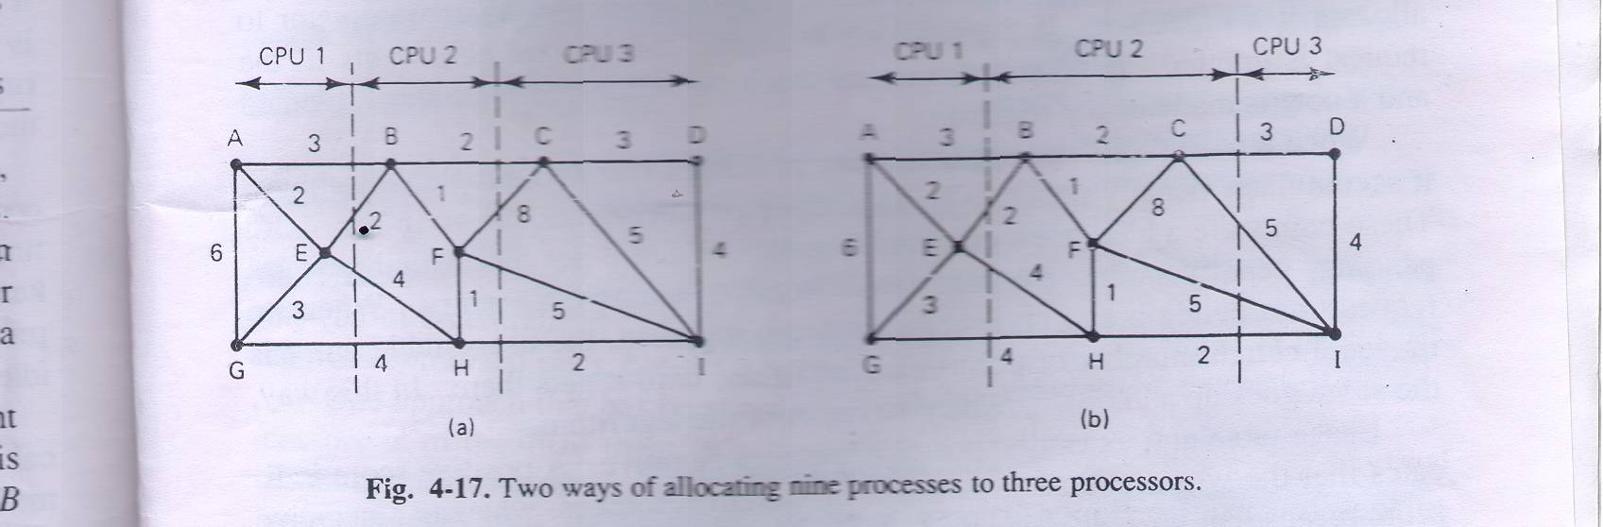
1. A Graph-Theoretic Deterministic Algorithm

Slide 47
1. A Graph-Theoretic Deterministic Algorithm
For each solution that meets the constraints, arcs that are entirely within the single subgraph represent intramachine communication and can be ignored while calculating n\w traffic here.
Arcs that go from one subgraph to another subgraph represent n\w traffic.
The goal is now to partitioning that minimizes the network traffic.
In figure we have shown two ways of partitioning the graphs.

Slide 48
1. A Graph-Theoretic Deterministic Algorithm
Why does this way this algorithm works in practice? Because when we are plotting the weighted graph at that time logically we are clustering or combining the processes at one place that requires communication with each other and later on we are putting them on the same machine. Right!
So now it is understandable.

Slide 49
2. A Centralized Algorithm OR Up-Down Algorithm
The previous algorithm which we saw is having limited applicability because it is deterministic by nature so it can be used for the system where the information about the processes are available in advance. Right!
But every time its not possible……
So let we learn one heuristic algorithm that does not require information about the nature of the processes and it is a centralized or Up-Down algorithm.

Slide 50
2. A Centralized Algorithm OR Up-Down Algorithm
Here it is centralized in the sense that coordinator maintains one usage table with one entry per personal workstation initially zero. Obviously!
When the significant events happen, messages are sent to the coordinator for updating the table.
Allocation decisions are based on the table.
And the decisions are needed to be taken when some event occurs like when processor is requested or the processor becomes free.

Slide 51
2. A Centralized Algorithm OR Up-Down Algorithm
The unusual thing about this algorithm and why it is centralized is that here instead of having the goal to maximize the CPU utilization , goal is to give each user the fair share of computing power.
This algorithm works as follow.
Here one thing should be keep in mind that when ever a processor or a workstation running its processes on other workstation or processors it gets per second fixed number of penalty points. And the workstations whose processes are pending to be run on some other machine will get point in minus that means credit. right!
And this is actually the entry in the central usage table.

Slide 52
2. A Centralized Algorithm OR Up-Down Algorithm
Now suppose some workstations are making requests for running its processes some where else ok! So this requests will be first sent to central coordinator which maintains the usage table so now the coordinator will make decision for deciding that which processor should be given first chance.
And coordinator will make this decision based on this fact.
It will check the usage table entry of each one of these and which ever workstations penalty points are least will be given the chance to run its processes on some other machine. Right!

Slide 53
2. A Centralized Algorithm OR Up-Down Algorithm
Usage table entry can be positive, zero, or negative.
A positive entry indicates that a workstation is using other workstation's computing power.
A zero entry indicates the neutral state.
And a negative entry indicates that this workstation is having many processes pending and it needs resources.
So when decision needs to be made at that time the workstation having least score will always beat the workstations having more penalty points.

Slide 54
2. A Centralized Algorithm OR Up-Down Algorithm
So here attempt is to not to let any single user dominate the system resources.
And each user should get fair share of computing power.

Slide 55
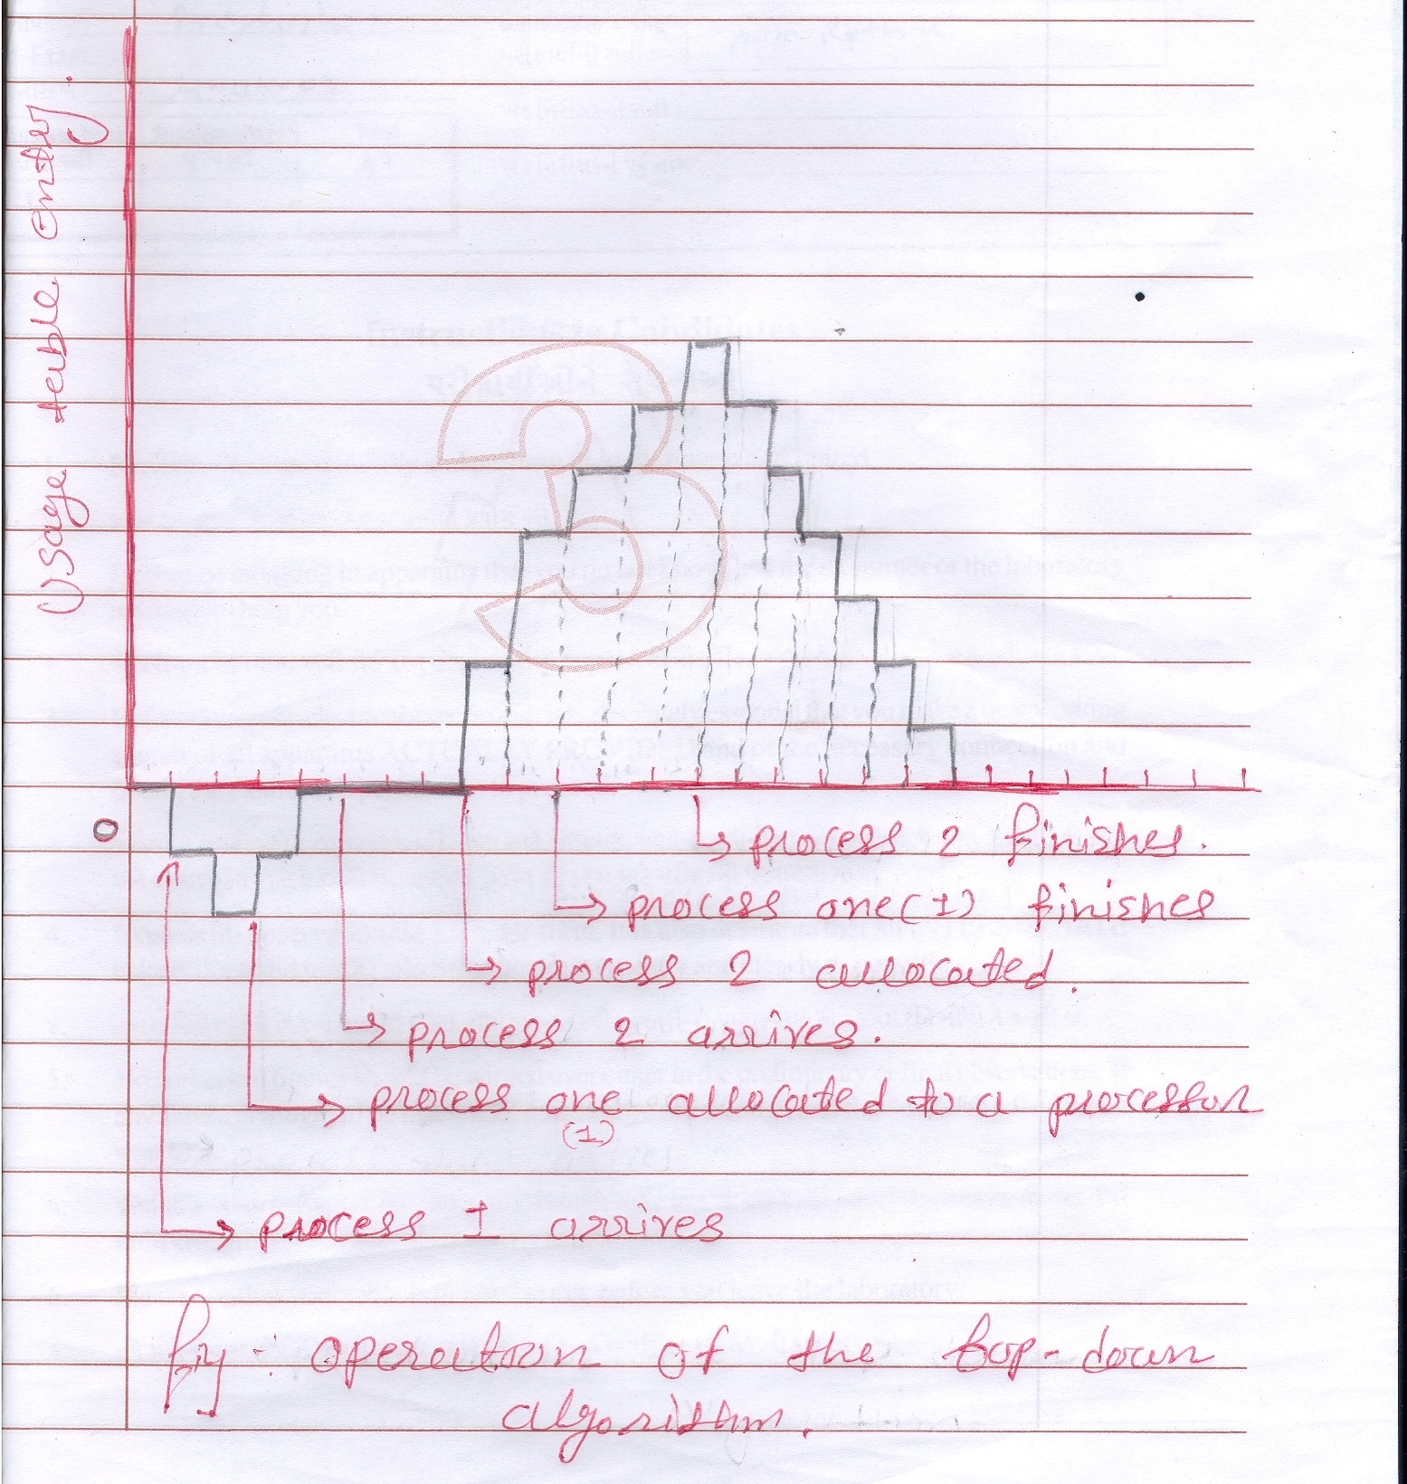
2. A Centralized Algorithm OR Up-Down Algorithm

Slide 56
3.A Hierarchical Algorithm
Centralized algorithm such as Up-Down do not scale well for the large system because it results in heavy load on that central component which is managing this algorithm. Right!
One approach that has been proposed for keeping tabs on a collection of processors is to organize them in a logical hierarchy independent on the logical structure.
For each group of K workers, one manager machine (the Department head) is assigned the task of keeping track of who is busy and who is idle.

Slide 57
3.A Hierarchical Algorithm
If the system is large then there will be more departmental heads, so some machines will function as a dean. And each governing some number of this departmental heads. And this way it can be extended.
An obvious question is that what happens when a department head stops functioning? One solution is to promote one of the direct subordinates of the faulty manager to fill in for the boss.
To avoid having the single authority at top we can truncate the tree so that now supreme authority is not single. Means the failure of one does not bring entire system down. Getting……

Slide 58
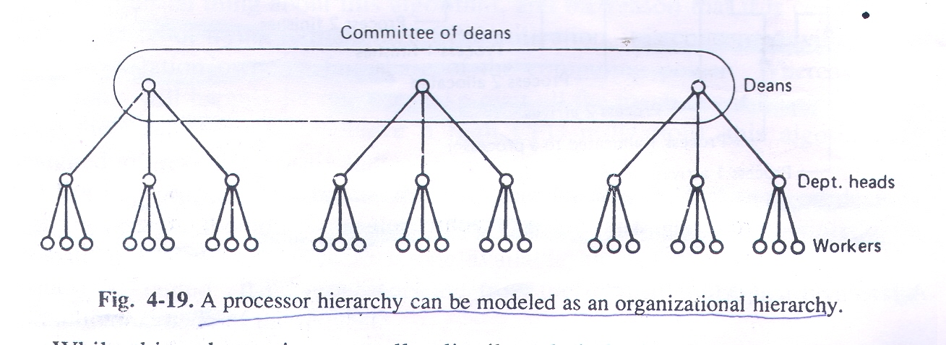
3.A Hierarchical Algorithm

Slide 59
3.A Hierarchical Algorithm
So here when one member malfunctions or crashes the remaining members promote someone one level down as replacement. Right!
So we can say that this system is self repairing and can survive occasional crashes of both workers and managers and manages without any long-term effects.

Slide 60
4.A sender initiated Distributed Algorithm
So far the algorithm that we have seen, are all centralized or semi-centralized. But in practice distributed algorithm also exits.
Here the machine on which the process has been created and wants to run or send it somewhere else , asks the probing question or inquiry question to some randomly selected machine. If that machine’s load is below some threshold value then it accepts that process otherwise denies.
And if it denies then some other machine is again randomly chosen and inquiry is made.

Slide 61
4.A sender initiated Distributed Algorithm
And this algorithm is repeated for N number of times.
If the suitable environment is not found in N probes then decision is made to run the process where it was originated.

Slide 62
5.A receiver initiated Distributed Algorithm
The previous algorithm is initiated by Overloaded sender where as complementary algorithm can be the one where underloaded receiver initiates the process.
So here when on particular machine process finishes so that underloaded machine randomly selects one machine and asks for work.
If it does not have work to give then it selects second machine and so on……
It continues this process for N probes and then stops.

Slide 63
5.A receiver initiated Distributed Algorithm
Again when second process finishes then it again initiates this algorithm or process.

